Slide 1
Data Communications for a Global Environment
Lecture 12

Slide 2
Chapter 3
Data Communications for a Global Environment
Physical Layer

Slide 3
Physical Layer - Overview
Data Communications for a Global Environment
Network Layer
Data Link Layer
Includes network hardware and circuits
Network circuits:
physical media (e.g., cables) and
special purposes devices (e.g., routers,switches and hubs).
Types of Circuits
Physical circuits connect devices & include actual wires such as twisted pair wires
Logical circuits refer to the transmission characteristics of the circuit.
Physical and logical circuits may be the same or different. For example, in multiplexing, one physical wire may carry several logical circuits.
Physical Layer

Slide 4
Types of Data Transmitted
Data Communications for a Global Environment
Analog data
Produced by telephones
Sound waves, which vary continuously over time, analogous to one’s voice
Can take on any value in a wide range of possibilities
Digital data
Produced by computers, in binary form
information is represented as code in a series of ones and zeros
All digital data is either on or off, 0 or 1

Slide 5
Types of Transmission
Data Communications for a Global Environment
Analog transmissions
Analog data transmitted in analog form
Example of analog data being sent using analog transmissions are radio (AM or FM)
Digital transmissions
Made of discrete square waves with a clear beginning and ending
Computer networks send digital data using digital transmissions
Data converted between analog and digital formats
Modem (modulator/demodulator): used when digital data is sent as an analog transmission
Codec (coder/decoder): used when analog data is sent via digital transmission

Slide 6
Data Type vs. Transmission Type
Data Communications for a Global Environment
 | Analog Transmission | Digital Transmission
Analog Data | AM and FM Radio, | Pulse code modulation, MP3, CDs, iPOD, cellphones, VoIP
Digital Data | Dial up modem sending email from your house | Codes such as ASCII or EBCDIC run over Ethernet LANs

Slide 7
Digital Transmission: Advantages
Data Communications for a Global Environment
Produces fewer errors
Easier to detect and correct errors, since transmitted data is binary (1s and 0s, only two distinct values)
A weak square wave can easily be propagated again in perfect form, allowing more crisp transmission than analog
Permits higher maximum transmission rates
e.g., Optical fiber designed for digital transmission
More efficient
Possible to send more digital data through a given circuit, circuit can be “packed”
More secure
Easier to encrypt digital bit stream
Simpler to integrate voice, video and data
Easier mix and match V, V, D on the same circuit, since all signals made up of 0’s and 1’s

Slide 8
Circuit Configuration
Data Communications for a Global Environment
Basic physical layout of the circuit
Configuration types:
Point-to-Point Configuration
Goes from one point to another
Sometimes called “dedicated circuits”
Multipoint Configuration
Many computer connected on the same circuit
Sometimes called “shared circuit”

Slide 9
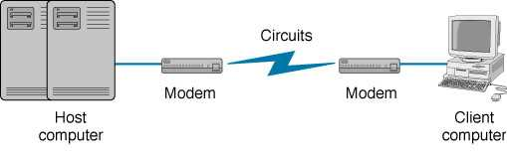
Point-to-Point Configuration
Data Communications for a Global Environment
Used when computers generate enough data to fill the capacity of the circuit
Each computer has its own circuit to reach the other computer in the network (expensive)

Slide 10
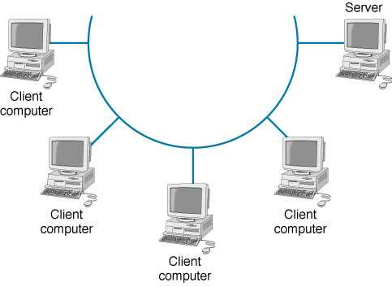
Multipoint Configuration
Data Communications for a Global Environment
Used when each computer does not need to continuously use the entire capacity of the circuit
+ Cheaper (not as many wires) and simpler to wire
- Only one computer can use the circuit at a time

Slide 11
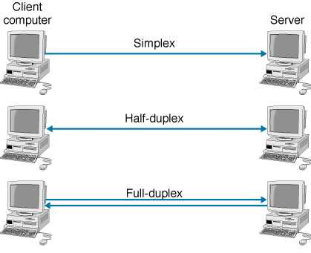
Data Flow (Transmission)
Data Communications for a Global Environment
data flows move in one direction only, (radio or cable television broadcasts)
data flows both ways, but only one direction at a time (e.g., CB radio, it requires control info)
data flows in both directions at the same time

Slide 12
Selection of Data Flow Method
Data Communications for a Global Environment
Main factor: Application
If data required to flow in one direction only
Simplex Method
e.g., From a remote sensor to a host computer
If data required to flow in both directions
Terminal-to-host communication (send and wait type communications)
Half-Duplex Method
Client-server; host-to-host communication (peer-to-peer communications)
Full Duplex Method
Capacity may be a factor too
Full-duplex uses half of the capacity for each direction

Slide 13
Multiplexing
Data Communications for a Global Environment
Breaking up a higher speed circuit into several slower (logical) circuits
Several devices can use it at the same time
Requires two multiplexer: one to combine; one to separate
Main advantage: cost
Fewer network circuits needed
Categories of multiplexing:
Frequency division multiplexing (FDM)
Time division multiplexing (TDM)
Statistical time division multiplexing (STDM)
Wavelength division multiplexing (WDM)

Slide 14
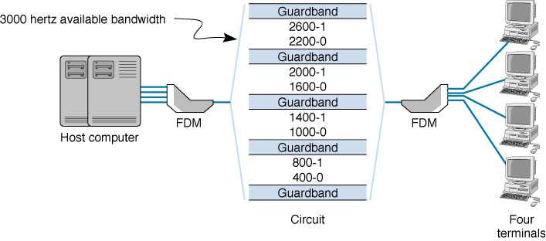
Frequency Division Multiplexing
Data Communications for a Global Environment
Makes a number of smaller channels from a larger frequency band by dividing the circuit “horizontally”
Used mostly by CATV
Guardbands needed to separate channels
To prevent interference between channels
Unused frequency bands are wasted capacity

Slide 15
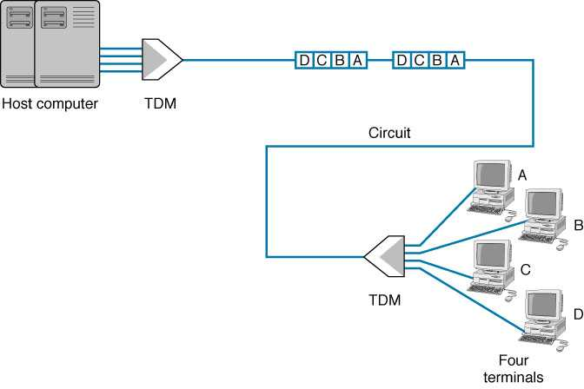
Time Division Multiplexing
Data Communications for a Global Environment
Dividing the circuit “vertically”
TDM allows multiple channels to be used by allowing the channels to send data by taking turns
This example shows 4 terminals sharing a circuit, with each terminal sending one character at a time

Slide 16
Comparison of TDM
Data Communications for a Global Environment
Time on the circuit shared equally
Each channel getting a specified timeslot whether needed or not
More efficient than FDM
Since TDM doesn’t use guardbands, entire capacity can be divided up between channels

Slide 17
Statistical TDM (STDM)
Data Communications for a Global Environment
Designed to make use of the idle time slots
In TDM, when terminals are not using the multiplexed circuit, timeslots for those terminals are idle
Uses non-dedicated time slots
Time slots used as needed by the different terminals
Complexities of STDM
Additional addressing information needed
Since source of a data sample is not identified by the time slot it occupies
Potential response time delays (when all terminals try to use the multiplexed circuit intensively)
Requires memory to store data (in case more data comes in than its outgoing circuit capacity can handle)

Slide 18
Wavelength Division Multiplexing
Data Communications for a Global Environment
Transmitting data at many different frequencies
Lasers or LEDs used to transmit on optical fibers
Previously single frequency on single fiber (typical transmission rate being around 622 Mbps)
Now multi frequencies on single fiber → n x 622+ Mbps
Dense WDM (DWDM)
Over a hundred channels per fiber
Each transmitting at a rate of 10 Gbps
Aggregate data rates in the low terabit range (Tbps)
Future versions of DWDM
Both per channel data rates and total number of channels continue to rise
Possibility of petabit (Pbps) aggregate rates

Slide 19
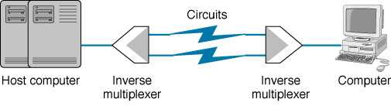
Inverse Multiplexing (IMUX)
Data Communications for a Global Environment
Shares the load by sending data over two or more lines
e.g., two T-1 lines used creating a combined multiplexed capacity of 2 x 1.544 = 3.088 Mbps)
Bandwidth ON Demand Network Interoperability Group (BONDING) standard
Commonly used for videoconferencing applications
Six 64 kbps lines can be combined to create an aggregate line of 384 kbps for transmitting video

Slide 20
Digital Subscriber Line (DSL)
Data Communications for a Global Environment
Became popular as a way to increase data rates in the local loop.
Uses full physical capacity of twisted pair (copper) phone lines (up to 1 MHz) instead of using the 0-4000 KHz voice channel
1 MHz capacity split into (FDM):
a 4 KHz voice channel
an upstream channel
a downstream channel
Requires a pair of DSL modems
One at the customer’s site; one at the CO site
May be divided further (via TDM) to have one or more logical channels

Slide 21
xDSL
Data Communications for a Global Environment
Several versions of DSL
Depends on how the bandwidth allocated between the upstream and downstream channels
A for Asynchronous, H for High speed, etc
G.Lite - a form of ADSL
Provides
a 4 Khz voice channel
384 kbps upstream
1.5 Mbps downstream (provided line conditions are optimal).

Slide 22
Communications Media
Data Communications for a Global Environment
Physical material that carries transmission
Guided media:
Transmission flows along a physical guide (Media guides the signal across the network)
Examples include twisted pair wiring, coaxial cable and fiber optic cable
Wireless media (radiated media)
No wave guide, the transmission flows through the air or space
Examples include radio such as microwave and satellite, as well as infrared communications

Slide 23
Twisted Pair (TP) Wires
Data Communications for a Global Environment
Commonly used for telephones and LANs
Reduced electromagnetic interference
Via twisting two wires together
(Usually several twists per inch)
TP cables have a number of pairs of wires
Telephone lines: two pairs (4 wires, usually only one pair is used by the telephone)
LAN cables: 4 pairs (8 wires)
Also used in telephone trunk lines (up to several thousand pairs)
Shielded twisted pair also exists, but is more expensive

Slide 24
Fiber Optic Cable
Data Communications for a Global Environment
Light created by an LED (light-emitting diode) or laser is sent down a thin glass or plastic fiber
Has extremely high capacity, ideal for broadband
Works well under harsh environments
Not fragile, nor brittle; Not heavy nor bulky
More resistant to corrosion, fire, water
Highly secure, know when is tapped
Fiber optic cable structure (from center):
Core (v. small, 5-50 microns, ~ the size of a single hair)
Cladding, which reflects the signal
Protective outer jacket

Slide 25
Wireless Media
Data Communications for a Global Environment
Radio
Wireless transmission of electrical waves through air
Each device has a radio transceiver with a specific frequency
Low power transmitters (few miles range)
Often attached to portables (Laptops, PDAs, cell phones)
Includes
AM and FM radios, Cellular phones
Wireless LANs (IEEE 802.11) and Bluetooth
Microwaves and Satellites, Low Earth Orbiting Satellites
Infrared
“invisible” light waves with frequency below red light spectrum
Requires line of sight; generally subject to interference from heavy rain, smog, and fog
Used in remote control units such as for controlling the TV

Slide 26
Microwave Radio
Data Communications for a Global Environment
High frequency form of radio communications
Extremely short (micro) wavelength (1 cm to 1 m)
Requires line-of-sight
Performs same functions as cables
Often used for long distance, terrestrial transmissions (over 50 miles without repeaters)
No wiring and digging required
Requires large antennas (about 10 ft) and high towers
Possesses similar properties as light
Reflection, Refraction, and focusing
Can be focused into narrow powerful beams for long distance
Some effect from water, rain and snow

Slide 27
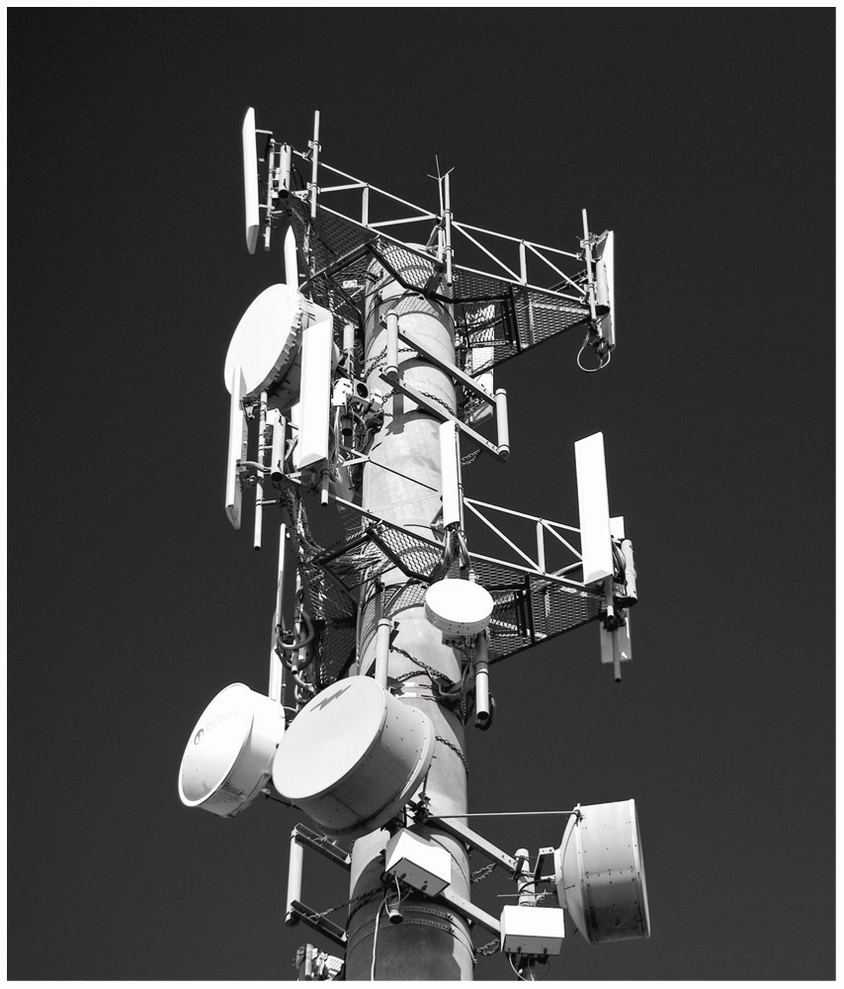
c03f012
c03f012

Slide 28
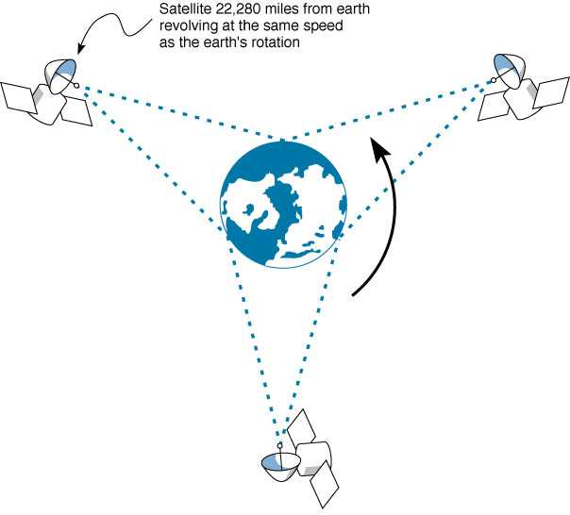
Satellite Communications
Data Communications for a Global Environment
Special form of microwave communications
Signals travel at speed of light, yet long propagation delay
due to great distance between ground station and satellite

Slide 29
Factors Used in Media Selection
Data Communications for a Global Environment
Type of network
LAN, WAN, or Backbone
Cost
Always changing; depends on the distance
Transmission distance
Short: up to 300 m; medium: up to 500 m
Security
Wireless media is less secure
Error rates
Wireless media has the highest error rate (interference)
Transmission speeds
Constantly improving; Fiber has the highest

Slide 30
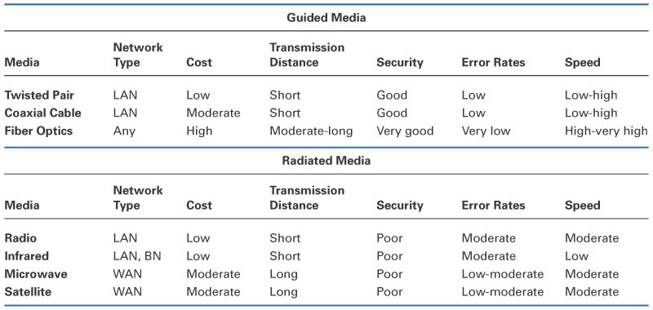
Media Summary
Data Communications for a Global Environment

Slide 31
Digital Transmission of Digital Data
Data Communications for a Global Environment
Computers produce binary data
Standards needed to ensure both sender and receiver understands this data
Codes: digital combinations of bits making up languages that computers use to represent letters, numbers, and symbols in a message
Signals: electrical or optical patterns that computers use to represent the coded bits (0 or 1) during transmission across media

Slide 32
Coding
Data Communications for a Global Environment
a character ← is represented by→ a group of bits
Letters (A, B, ..),
numbers (1, 2,..),
special symbols (#, $, ..)
1000001
ASCII: American Standard Code for Information Interchange
Originally used a 7-bit code (128 combinations), but an 8-bit version (256 combinations) is now in use
Found on PC computers
EBCDIC: Extended Binary Coded Decimal Interchange Code
An 8-bit code developed by IBM
Used mostly in mainframe computer environment

Slide 33
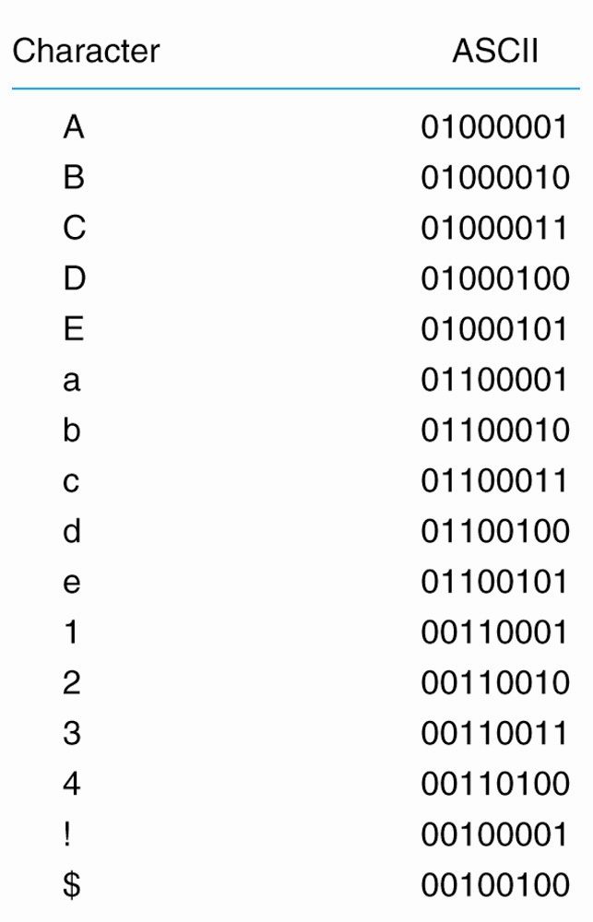
c03f015
Data Communications for a Global Environment
c03f015

Slide 34
Transmission Modes
Data Communications for a Global Environment
Bits in a message can be sent:
A single wire one after another (Serial transmission)
Multiple wires simultaneously (Parallel transmission)
Serial Mode
Sends bit by bit over a single wire
Serial mode is slower than parallel mode
Parallel mode
Uses several wires, each wire sending one bit at the same time as the others
A parallel printer cable sends 8 bits together
Computer’s processor and motherboard also use parallel busses (8 bits, 16 bits, 32 bits) to move data around

Slide 35
Signaling of Bits
Digital Transmission
Signals sent as a series of “square waves” of either positive or negative voltage
Voltages vary between +3/-3 and +24/-24 depending on the circuit
Signaling (encoding)
Defines how the voltage levels will correspond to the bit values of 0 or 1
Examples:
Unipolar, Bipolar
RTZ, NRZ, Manchester
Data rate: describes how often the sender can transmit data
64 Kbps → once every 1/64000 of a second

Slide 36
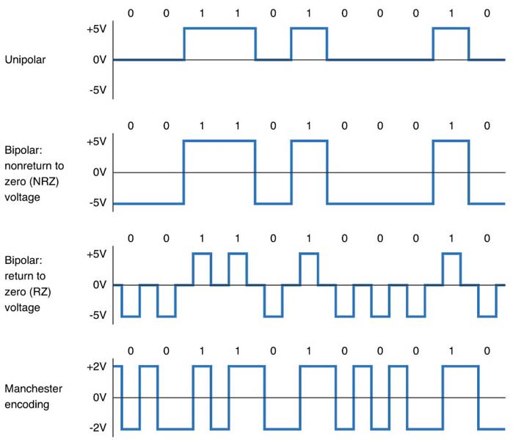
Digital Transmission Types
Data Communications for a Global Environment

Slide 37
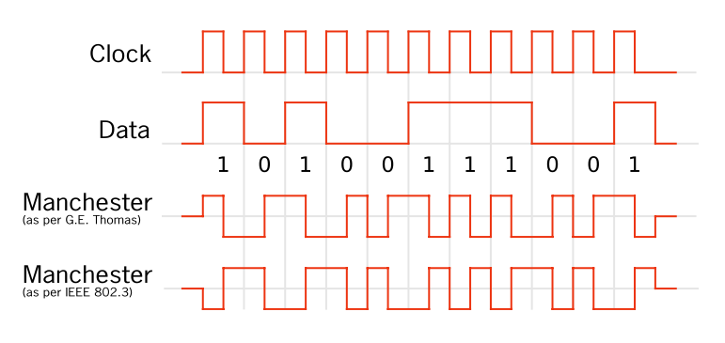
Manchester Encoding
Data Communications for a Global Environment
original data = clock XOR Manchester value 0 0 0 0 1 1
1 0 1
1 1 0

Slide 38
Analog Transmission of Digital Data
Data Communications for a Global Environment
A well known example using phone lines to connect PCs to Internet
PCs generate digital data
Local loop phone lines use analog transmission technology
Modems translate digital data into analog signals
Typically digital from Central Office on in networks
Internet
Local loop phone line
Telephone
Network
PC
M
Often analog transmission of data
Telco Central Office
Digital data

Slide 39
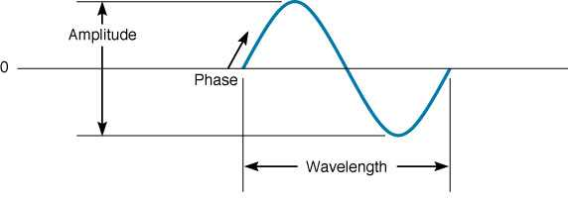
Sound Waves and Characteristics
Data Communications for a Global Environment
90º
Amplitude
Height (loudness) of the wave
Measured in decibels (dB)
Frequency:
Number of waves that pass in a second
Measured in Hertz (cycles/second)
Wavelength, the length of the wave from crest to crest, is related to frequency
Phase:
Refers to the point in each wave cycle at which the wave begins (measured in degrees)
(For example, changing a wave’s cycle from crest to trough corresponds to a 180 degree phase shift).
0º
180º
360º
270º

Slide 40
Wavelength vs. Frequency
Data Communications for a Global Environment
speed = frequency * wavelength
v = f λ
v = 3 x10⁸ m/s
= 300,000 km/s
= 186,000 miles/s
Example:
if f = 900 MHz
λ = 3 x10⁸ / 900 x 10 ³
= 3/9 = 0.3 meters
λ

Slide 41
Modulation
Data Communications for a Global Environment
Μodification of a carrier wave’s fundamental characteristics in order to encode information
Carrier wave: Basic electronic wave transmitted through the circuit (provides a base which we can deviate)
Βasic ways to modulate a carrier wave:
Amplitude Modulation (AM)
Also known as Amplitude Shift Keying (ASK)
Frequency Modulation (FM)
Also known as Frequency Shift Keying (FSK)
Phase Modulation (PM)
Also known as Phase Shift Keying (PSK)

Slide 42
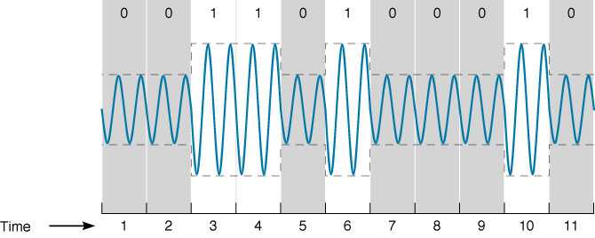
Amplitude Modulation (AM)
Data Communications for a Global Environment
Changing the height of the wave to encode data
One bit is encoded for each carrier wave change
A high amplitude means a bit value of 1
Low amplitude means a bit value of 0
More susceptible noise than the other modulation methods

Slide 43
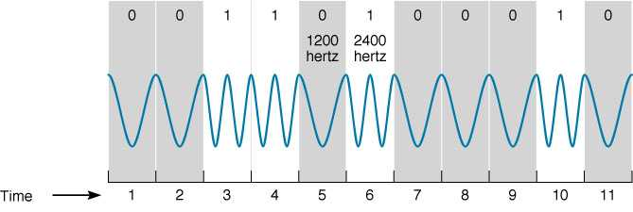
Frequency Modulation (FM)
Data Communications for a Global Environment
Changing the frequency of carrier wave to encode data
One bit is encoded for each carrier wave change
Changing carrier wave to a higher frequency encodes a bit value of 1
No change in carrier wave frequency means a bit value of 0

Slide 44
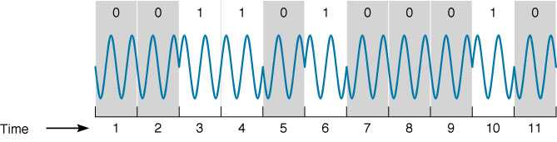
Phase Modulation (PM)
Data Communications for a Global Environment
Changing the phase of the carrier wave to encode data
One bit is encoded for each carrier wave change
Changing carrier wave’s phase by 180º corresponds to a bit value of 1
No change in carrier wave’s phase means a bit value of 0

Slide 45
Concept of Symbol
Data Communications for a Global Environment
Sending Multiple Bits Simultaneously
Symbol: The number of bits encoded per wave. The number of bits b require 2^{n} different amplitudes.
Example:
Sending one bit of information at a time
One bit encoded for each symbol (carrier wave change) → 1 bit per symbol requires two amplitudes
Sending 2 bits simultaneously
2 bits encoded for each symbol (carrier wave change) → 2 bits per symbol requires 4 amplitudes,

Slide 46
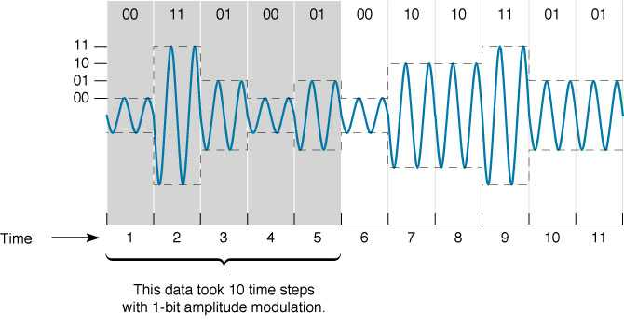
Example: Two-bit AM
Data Communications for a Global Environment
4 symbols

Slide 47
Sending Multiple Bits per Symbol
Data Communications for a Global Environment
Possible number of symbols must be increased
1 bit of information → 2 symbols
2 bits of information → 4 symbols
3 bits of information 8 → symbols
4 bits of information → 16 symbols
n bits of information → 2^{n} symbols
Multiple bits per symbol might be encoded using amplitude, frequency, and phase modulation
e.g., PM: phase shifts of 0º, 90º, 180º, and 270º
Subject to limitations: As the number of symbols increases, it becomes harder to detect differences and is more prone to error

Slide 48
Bit Rate vs. Baud Rate or Symbol Rate
Data Communications for a Global Environment
Bit: a unit of information
Baud: a unit of signaling speed
Bit rate (or data rate): b
Number of bits transmitted per second
Baud rate or symbol rate: s
number of symbols transmitted per second
General formula:
b = s x n
where
b = Data Rate (bits/second)
s = Symbol Rate (symbols/sec.)
n = Number of bits per symbol
Example: AM
n = 1
→ b = s
Example: 16-QAM
n = 4
→ b = 4 x s

Slide 49
Bandwidth of a Voice Circuit
Data Communications for a Global Environment
Difference between the highest and lowest frequencies in a band or set if frequencies
Human hearing frequency range: 20 Hz to 14 kHz
Bandwidth = 14,000 – 20 = 13,080 Hz
Voice circuit frequency range: 0 Hz to 4 kHz
Designed for most commonly used range of human voice
Phone lines transmission capacity is much bigger
1 MHz for lines up to 2 miles from a telephone exchange
300 kHz for lines 2-3 miles away

Slide 50
Data Capacity of a Voice Circuit
Data Communications for a Global Environment
Fastest rate at which you can send your data over the circuit (in bits per second)
Calculated as the bit rate: b = s x n
Depends on modulation (symbol rate)
Max. Symbol rate = bandwidth (if no noise)
Maximum voice circuit capacity:
Using QAM with 4 bits per symbol (n = 4)
Max. voice channel carrier wave frequency: 4000 Hz = max. symbol rate (under perfect conditions)
→Data rate = 4 * 4000 → 16,000 bps
A circuit with a 10 MHz bandwidth using 64-QAM could provide up to 60 Mbps.

Slide 51
Digital Transmission of Analog Data
Data Communications for a Global Environment
Analog voice data sent over digital network using digital transmission
Requires a pair of special devices called Codec - Coder/decoder
A device that converts an analog voice signal into digital form
Converts it back to analog data at the receiving end
Used by the phone system
Modem is reverse device than Codec, and this word stands for Modulate/Demodulate. Modems are used for analog transmission of digital data.

Slide 52
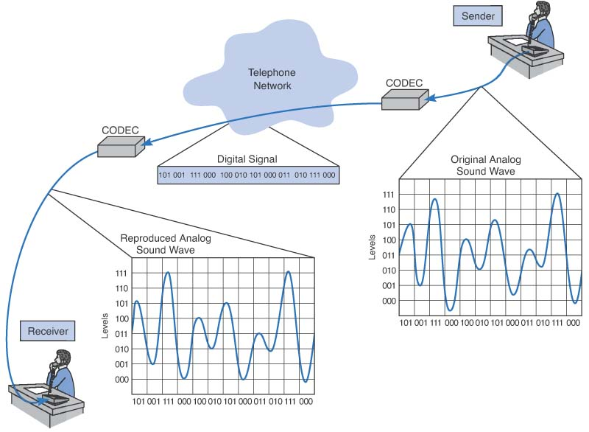
PAM for Telephones
Data Communications for a Global Environment

Slide 53
Analog to Digital Conversion
Data Communications for a Global Environment
Analog data must be translated into a series of bits before transmission onto a digital circuit
Done by a technique called Pulse Amplitude Modulation (PAM) involving 4 steps:
Take samples of the continuously varying analog signal across time
Measure the amplitude of each signal sample
Encode the amplitude measurement of the signal as binary data that is representative of the sample
Send the discrete, digital data stream of 0’s and 1’s that approximates the original analog signal
Creates a rough (digitized) approximation of original signal
Quantizing error: difference between the original analog signal and the replicated but approximated, digital signal
The more samples taken in time, the less quantizing error

Slide 54
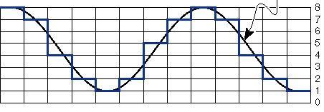
PAM – Measuring Signal
Data Communications for a Global Environment
Original wave
8 pulse amplitudes
time
Sample analog waveform across time and measure amplitude of signal
In this example, quantize the samples using only 8 pulse amplitudes or levels for simplicity
Our 8 levels or amplitudes can be depicted digitally by using 0’s and 1’s in a 3-bit code, yielding 2³ possible amplitudes

Slide 55
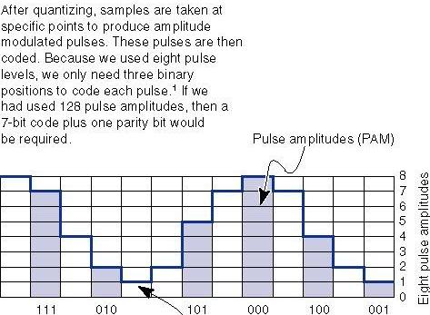
PAM – Encoding and Sampling
Data Communications for a Global Environment
Pulse Amplitudes
000 – PAM Level 1
001 – PAM Level 2
010 – PAM Level 3
011 – PAM Level 4
100 – PAM Level 5
101 – PAM Level 6
110 – PAM Level 7
111 – PAM Level 8
8 pulse amplitudes
Digitized signal
For digitizing a voice signal, it is typically 8,000 samples per second and 8 bits per sample
8,000 samples x 8 bits per sample → 64,000 bps transmission rate needed
8,000 samples then transmitted as a serial stream of 0s and 1s

Slide 56
Minimize Quantizing Errors
Data Communications for a Global Environment
Increase number of amplitude levels
Difference between levels minimized → smoother signal
Requires more bits to represent levels → more data to transmit
Adequate human voice: 7 bits → 128 levels
Music: at least 16 bits → 65,536 levels
Sample more frequently
Will reduce the length of each step → smoother signal
Adequate Voice signal: twice the highest possible frequency (4Khz x 2 = 8000 samples / second) Nyquist
theorem.
RealNetworks: 48,000 samples / second

Slide 57
PCM - Pulse Code Modulation
Data Communications for a Global Environment
phone switch
(DIGITAL)
local loop
trunk
To other switches
Analog transmission
Central Office
(Telco)
Digital transmission
convert analog signals to digital data using PCM (similar to PAM)
DS-0 is the basic digital communications unit used by phone network
DS-0 corresponds to 1 digital voice signal
8000 samples per second and 8 bits per sample (7 bits for sample + 1 bit for control)
→ 64 Kb/s (DS-0 rate)

